Slide 1
Finite Element Approximation for Convection, Diffusion and Reaction Systems in a Tubular Reactor
St. Elmo Wilken
Notes:
Good morning! Today I’m going to talk about reactor modelling with the help of the finite element method.

Slide 2
Overview
Typical Chemical Engineering reactor design problem.
Used the Finite Element Method to solve the modelling problems.
Uncoupled, linear, coupled and non-linear partial differential equations are solved.
Notes:
My project dealt with the modelling of convection, diffusion and reaction systems in a tubular reactor using the FEM to solve the models. The type of problems I solved are typical reactor design problems one would encounter in practice albeit with some assumptions to simplify the models.
Before I proceed I will give a brief background on the important concepts and ideas used in my project.

Slide 3
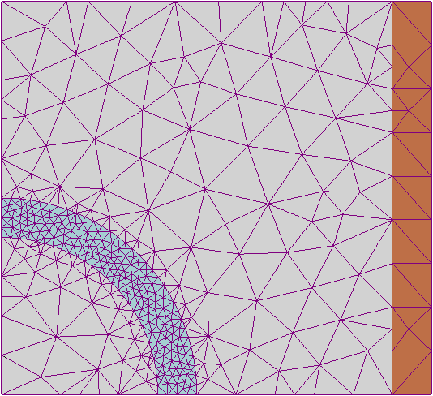
The Finite Element Method
Advanced numerical scheme to solve PDEs.
Attempts to find a function in a reduced space which is the best approximation of the exact solution.
Useful if complex geometrical features need to be modelled.
Notes:
The FEM is a numerical method which is mostly used to solve partial differential equations. Broadly speaking the method attempts to find a function in some reduced space which is the best approximation of the exact solution in that space. The method is most often used to solve structural problems, for example beam type problems, but can also be used to solve the type of problems we will encounter today.
The FEM has several advantages over less sophisticated methods like the finite difference method. The two most important advantages are:
Its ability to handle complex geometries efficiently
And the elegant way in which natural boundary conditions are handled.
One of the distinguishing features of the FEM is the mesh component of the solution process as shown here. Local solutions satisfying the equation under investigation are constructed over the mesh of the problem domain. These mesh elements are stitched together to yield an approximation which satisfies the equation globally. The mesh shown here illustrates how the FEM handles a complicated geometry and how it is easy to selectively increase the accuracy in areas by creating a smaller mesh there. This is computationally advantageous because one can choose were the most computational power should be directed with ease.

Slide 4
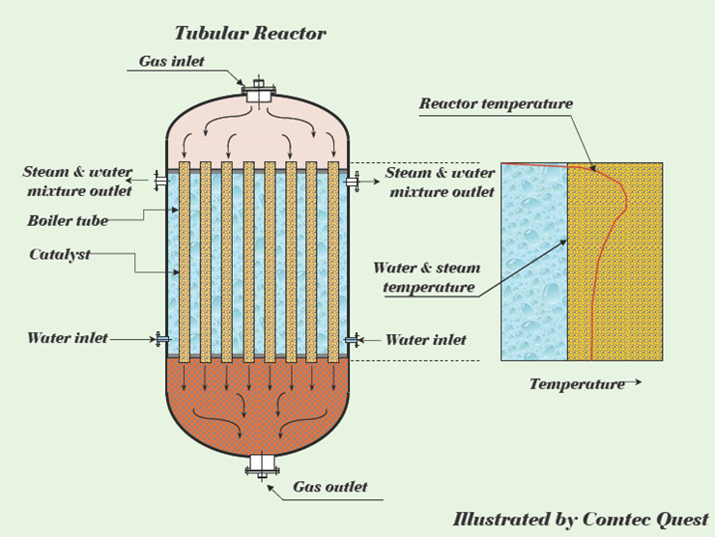

Tubular Reactor
Very common reactor type.
Built-in temperature control causes complex internal geometry.
Even at steady state there is necessarily a concentration gradient across the reactor.
Notes:
There are many different types of reactors found on your average industrial chemical plant. A very commonly used one is the tubular reactor. Physically it is just a pipe, often packed with catalyst, through which reagent flows. The reaction occurs down the length of the pipe as the reagents flow through it. In my project I studied a simple tubular reactor with no catalyst or internal cooling mechanisms, just to keep things simple – effectively this is just a straight empty pipe. Although this assumption may seem overly simplistic these types of reactors do exist! However, more complicated reactors, like the one shown here would very often have internal cooling tubes to control the reaction – in situations like these the FEM would be really useful because the more complicated geometry would be easy to handle.
Tubular reactors can be tricky to model due to concentration, temperature and pressure gradients which invariably exist even at steady state. In this presentation we will only be concerned with concentration and temperature gradients.

Slide 5
Outline
Brief illustration of model derivation
Isothermal models
Non-Isothermal models
Notes:
Now that we have a better idea of the building blocks of the project I will briefly describe the outline of the presentation.
In the first section I will describe the modelling process behind the entire project. This includes a derivation of the equations describing how the concentration and temperature of the reagents change along the length and width of the reactor.
In the next section I will apply the derived concentration model at a constant temperature to a toy problem – this is called isothermal modelling because it is assumed that the temperature stays constant throughout the reactor.
In the next section I drop the constant temperature assumption and discuss the difficulties this introduces. I will then discuss and illustrate ways to overcome these difficulties.

Slide 6
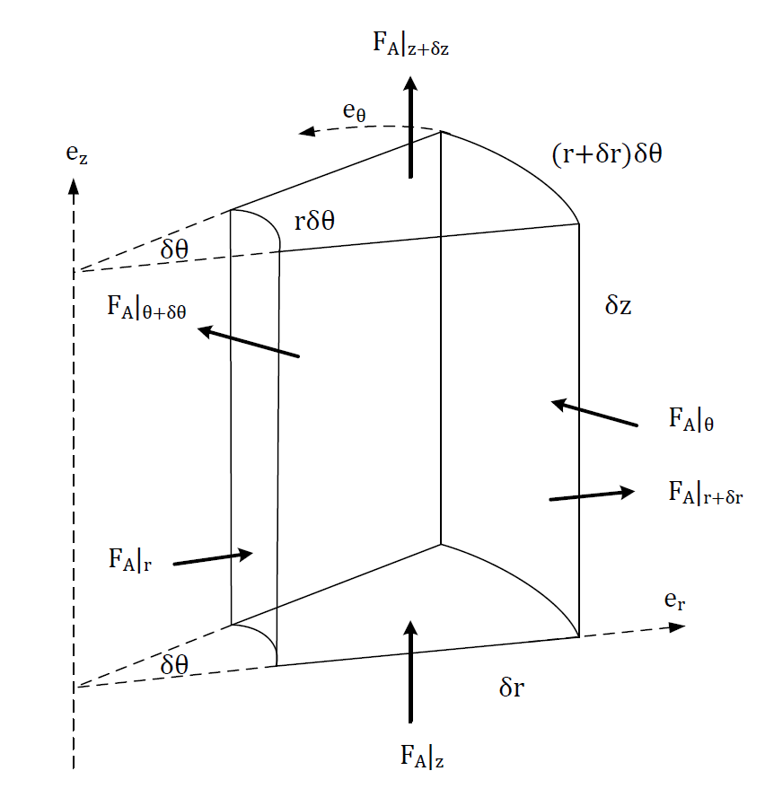

Model Derivation
Conservation of Mass → Mole Balance.
In – Out + Generation = Accumulation in control volume.
Natural coordinates for tubular reactor = Cylindrical Coordinates.
Notes:
No doubt everyone has heard of the conservation of mass principle. It states that matter can neither be created nor destroyed, stated differently, given some control volume with no net change in mass flows into or out of it, the mass stays constant within the control volume.
A natural consequence of this is the mole balance. Broadly speaking it states that given a control volume the number of moles within it stays constant if no reaction occurs and the net flows do not change. Another way of saying this is: the number of moles flowing INTO the system – the number of moles flowing OUT of the system + the number of moles GENERATED or CONSUMED by reaction is equal to the ACCUMULATION inside the control volume.
Since we are working with a tubular reactor I chose to work with cylindrical coordinates because they are more natural in this setting. The equation you see at the bottom of the slide is the mole balance in cylindrical coordinates.
Show flow terms, reactions terms and accumulation terms.

Slide 7
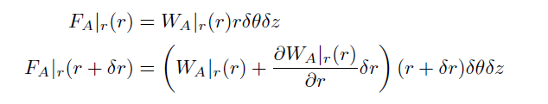


Model Derivation
Linear approximation and definition of molar flux substituted into mole balance for each component.
Resultant flux equation needs constitutive equations to relate flux to concentration.
Notes:
By taking the linear approximation of the molar flows in the control volume and making use of the definition of flux (since the flows happen across a surface) we have the flux equation of the mole balance. As you can see it is composed of flux, concentration and reaction terms. Clearly constitutive equations are necessary to make it physically useful.

Slide 8
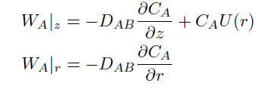

Model Derivation
We use Fick’s Law as the constitutive equations.
Assume convection only occurs in the axial direction and that rotational variations are negligible.
Convection, Diffusion and Reaction model:
Notes:
To get rid of the flux terms we use Fick’s Law. This relates the flux to a concentration gradient in the direction of the flux component. We also assume that convection only occurs in the axial direction – along the length of the reactor. This is why the velocity term is missing from the second constitutive equation. We also assume that the reactor is rotationally symmetrical and thus we neglect the theta component. We effectively only consider a two dimensional model – the axial and radial directions.
Substituting all of this into the flux equation we are left with the convection, diffusion and reaction equation. To understand what this physically models we will explain what each term means separately.

Slide 9
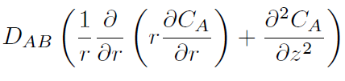


Model Derivation
Diffusion – natural dispersion:
Convection – forced dispersion:
Reaction – generation or consumption of some species:
Convection, Diffusion Reaction Equation:
Notes:
To understand what diffusion is, recall what happens when you make tea and just leave the teabag floating in the cup. Over time the hot water changes colour as the tea dissolves into the liquid. This process is called diffusion and is often quite slow. The constant D_AB is the diffusion coefficient and indicates how quickly species A diffuses into species B.
Convection, or sometimes called advection, is roughly what happens when you stir the cup vigorously to get the tea to dissolve faster. Obviously diffusion also happens but the convection process dominates the dynamics of the system. The factor U_z is the velocity of the fluid in the axial direction.
Reaction is exactly what it sounds like, the reagents turn into products!
Combining all of these effects we have the CDR equation in two dimensions.

Slide 10
Model Derivation
So far only a mole balance has been performed. In practice it is EXTREMELY important to also take into account the energy balance.
High temperatures are dangerous and can also affect product quality.
We proceed in exactly the same way.
Notes:
In the previous slide we finished with the convection, diffusion and reaction equation which describes the concentration profile of the reactor. Another practically crucial model we still require is the energy balance. The energy balance models how the temperature will change in the reactor given the reaction. It is very important to couple the mole balance with the energy balance because excessively high or uncontrolled temperatures can be very dangerous on a chemical plant.
Fortunately the derivation of the energy balance follows along very similar lines as the CDR equation.

Slide 11





Model Derivation
We use power law kinetics and the Arrhenius equation to model the reaction dynamics and dependence on temperature.
Temperature model for the CDR equation is:
Notes:
Before we continue with the energy balance we should talk about the reaction term. The reaction term converts the reagents into (hopefully) chemically useful products. A very common class of reaction kinetics is the power law rate equation as shown here. The rate factor K usually depends on temperature and is modelled by the Arrhenius equation. Clearly this term is quite non-linear due to the composition of the exponential and hyperbola functions. More complicated rate expressions exist but we will restrict our attention to this kind for simplicity.
The rate equation examples shown here show how reagent A turns into product B via a power law expression and how reagents A and B turn into product C. Typically M and N are small integers e.g. 1,2 or 3.
By following the same procedure as in the CDR model derivation we end up with the associated temperature model. Since they are both derived in the same way it comes as no surprise that they look very similar. The terms have almost the exact same meaning as in the CDR equation except that they now model temperature as opposed to concentration.
Finally, we are now ready to model actual systems.

Slide 12

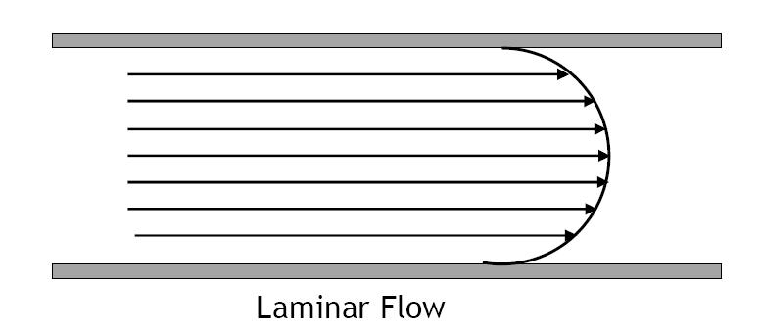


Isothermal Models - Overview
Two dimensional model with laminar flow.
One dimensional model using Aris-Taylor approximation.
Compare accuracy using simplification.
Notes:
As I mentioned before we will first neglect any temperature variations and focus exclusively on the isothermal CDR equation. The two dimensional equation is the same as CDR equation we derived earlier. As you can see the velocity term is slightly more complex now – we have assumed a laminar flow profile of the fluid. We have also assumed very simple first order power law kinetics for the rate term.
Since this partial differential equation has 3 dependent variables (r, z and t) it is quite difficult to solve analytically. We thus look for a way to simplify this equation. The Aris-Taylor approximation is a technique where average concentrations are taken at each axial position. The radial diffusion component is then lumped together with the axial term to simplify the two dimensional equation into a one dimensional model. At steady state this is a relatively simple second order differential equation and is extensively used in practice to get a feeling for the system without solving the two dimensional problem.
One of the goals of this project is to investigate the accuracy of the approximation. To do this the two dimensional model will be compared to one dimensional simplified model using the same kinetics. Although this is not a thorough investigation of the accuracy of the approximation it will give some indication of its usefulness.

Slide 13


Non-Isothermal Models - Overview
Ideally we would like to investigate the same system with temperature dependence.
Much more complicated because it is non-linear and coupled.
This is future work.
Rather consider each complication separately to develop understanding.
Notes:
Ideally we would also like to investigate the same system with the temperature dependence. The complete model for this situation is shown below. This system is clearly quite challenging because it is non-linear, coupled and has non-constant coefficients. We leave this problem for future work and focus rather on developing techniques to solve these types of problems by focussing on developing methods which can handle non-linear and coupled problems. To this end we tackle each of these complications separately.

Slide 14

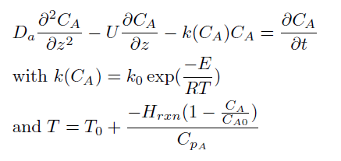
Uncoupled Non-Linear Model
Assume adiabatic conditions.
One dimensional model then becomes:
Notes:
The first non-isothermal system we investigate is an adiabatic model of the same scheme as before. Adiabatic means that no energy enters or leaves the system i.e. the reactor is insulated. The problem is shown in the slide for the one dimensional case. Clearly this problem has the difficult non-linearity seen before but lacks the coupled aspect. We only consider the one dimensional case for the adiabatic model because the techniques we develop carry over directly to higher dimensions.

Slide 15
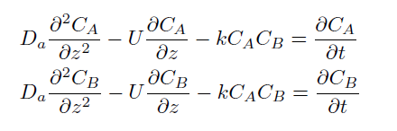
Coupled Non-Linear Model
Assume isothermal conditions.
Assume new reaction scheme.
Still non-linear but easier to handle than the non-linearity introduced by the temperature balance.
Notes:
Lastly we investigate another isothermal model but this time it is coupled in the reaction term. In this problem two reagents, A and B, react together to form product C. The second order rate law introduces some non-linearity but this is easier to handle than the Arrhenius equation with the exponential term as seen before. The coupled aspect is important because if the reagents have different initial concentrations it will affect the rate of the reaction. Again we only consider the one dimensional case because the techniques we develop will carry over to higher dimensions.

Slide 16
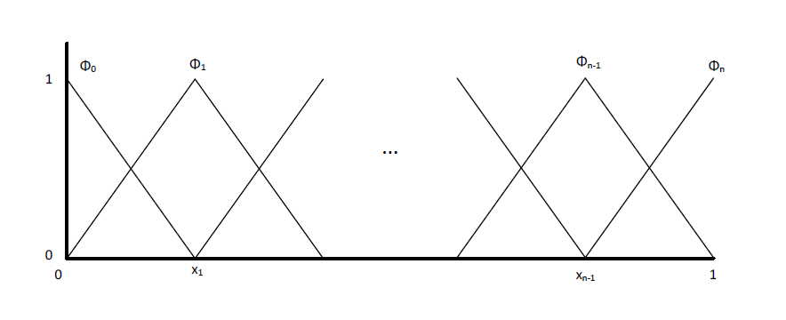
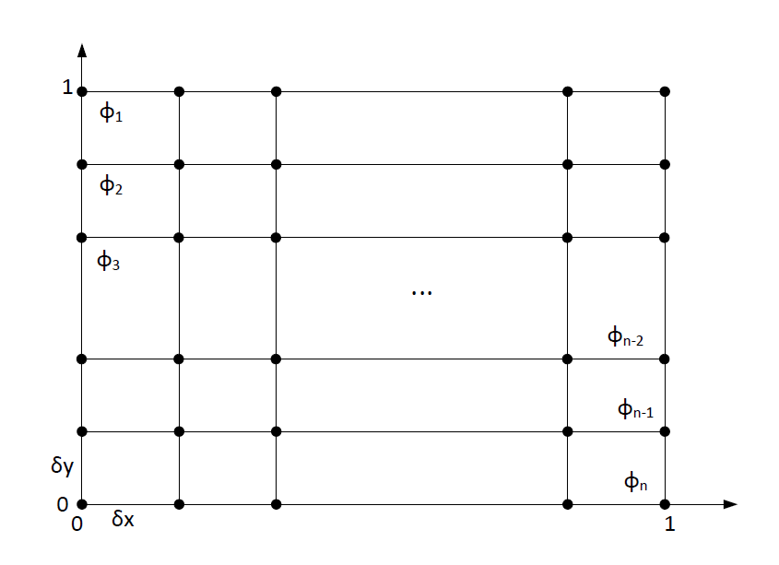
Finite Element Method Details
For the one dimensional models we used piecewise linear basis functions.
For the two dimensional models we used piecewise bilinear rectangular basis functions
Notes:
Now we are in a position to numerically model the four problems touched upon earlier. Before we start modelling let’s just be clear on how the FEM was implemented. For the one dimensional problems piecewise linear basis functions, also called roof or hat functions, were used. For the two dimensional problems piecewise bilinear rectangular basis functions were used. In all the simulations the FEM was applied to the spatial dimensions but the resulting system of ODEs was solved using the Crank-Nicolson method in the temporal dimension.
All the one dimensional problems model the concentration along the centre axis line of the reactor while the two dimensional problems model the radial and axial plane along the reactor. Since we assumed the reactor is rotationally symmetrical this describes the entire reactor. As far as the mesh over the reactor domain is concerned we used regular equi-distant elements for simplicity.

Slide 17
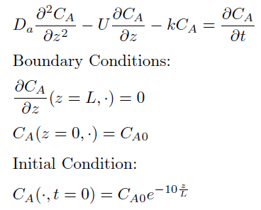
One Dimensional Isothermal Model
Linear uncoupled model.
Lumped convection/diffusion coefficient.
Unsteady initial condition models an initially inert reactor.
Boundary conditions model a constant initial concentration at the entrance of the reactor and no reaction at the exit of the reactor
Notes:
The first problem we solve is the unsteady one dimensional linear uncoupled problem. This model makes use of the Aris-Taylor simplification as discussed before.
The initial condition models an initially inert reactor – to prevent numerical issues arising from the discontinuity of this condition, a smooth artificial profile is created which quickly reaches 0 in the start of the reactor. Basically this reactor is filled with some inert fluid which is displaced as the reagents enter the reactor.
The boundary conditions are quite standard: they model a situation where a known concentration of reagent enters the reactor and no reaction takes place at the end of the reactor. Thus the reaction starts at the mouth of the reactor and ends at the reactor exit. The reaction is a simple first order power law expression modelling a reaction scheme which turns reagent A into product B.

Slide 18
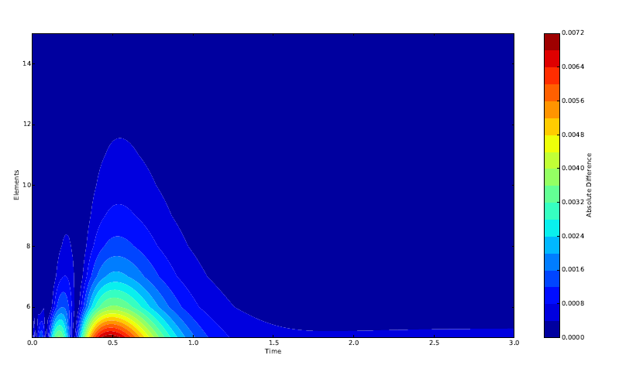
One Dimensional Isothermal Model
Assume existence and uniqueness of the exact solution.
Assume that if the approximation converges it converges to the exact solution.
Numerical convergence at the end of the reactor:
Here
Notes:
Since the project focussed mainly on the modelling aspects of the CDR equation we assumed the existence and uniqueness of the solution to the model. We also assumed that if the numerical method converges it indeed converges to the exact solution. Finally, we also assumed that any computational problems such as rounding errors were negligible. Thus, all which is left to test is whether or not the scheme converges.
To justify the proposition that the scheme indeed converges we investigate the behaviour of successive differences of the approximate solution using more elements at the end point of the reactor over a large time span. We chose the end point because practically this is the most important region of the reactor. The diagram shows that the absolute difference between successive approximations using one more element each time rapidly approaches zero. Colder colours indicate a smaller difference and warmer colours indicate a greater difference. As more elements are used it is clear that less and less change in the approximation value is observed. Based on this we believe that it is safe to conclude that the scheme does indeed converge.

Slide 19
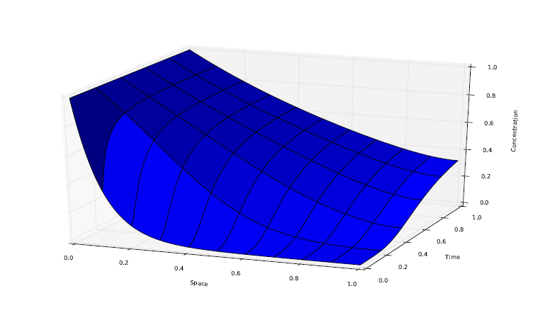
One Dimensional Isothermal Model
Physical realistic approximation.
Note that dimensionless units are used.
Notes:
Finally we show the modelled transient response of the reactor. It is clear that as time passes the concentration of the reagent increases due to the flow of the reagent through the reactor to a point and then, because of the reaction, levels out to a steady state conversion of about 70%. Qualitatively nothing appears out of the ordinary and thus we conclude that the modelling exercise was successful.

Slide 20

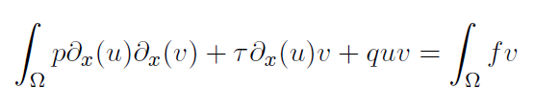
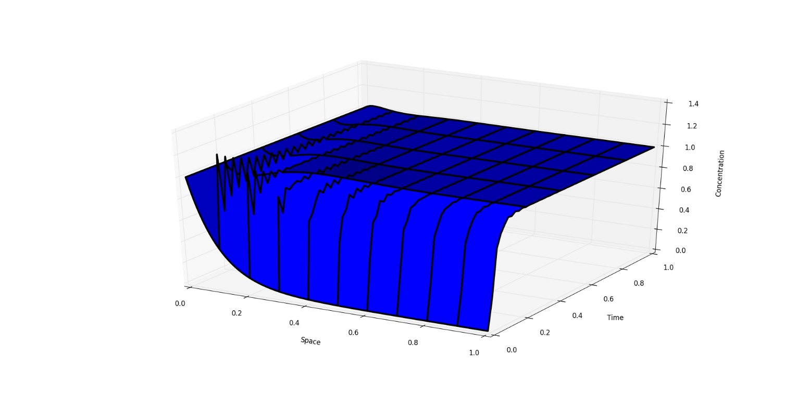




A Note on Convergence and Stability
Notes:
This project deals primarily with the CDR equation which makes it analytically more difficult to study than the more standard heat or diffusion equation one generally encounters at this level. The major difference between something like the heat or diffusion equation and the CDR equation is that the latter equation is not symmetric due to the convection term. Consider the more general steady one dimensional problem shown here as an example. If we multiply through by some suitably test function and reduce the problem to its weak form using standard methods we have the second equation. This naturally suggests an inner product A but upon closer inspection we see that this inner product is not symmetric! This unfortunate property precludes the standard method of proving convergence, uniqueness and existence for simpler FEM problems!
To solve this problem one needs to extend the inner product to complex functions. By doing this one can proceed more or less as one would for simpler problems. A result in the book by Strang and Fix assures us that even for problems like this the FEM approximation is closer to the exact solution than anything else in the test function space.
However, despite the convergence guarantees, the FEM might not always generate realistic results. If the convection term dominates the diffusion term the approximation will not be accurate. Standard FEM is not appropriate for this type of problem in the same way as centred differences are not appropriate for the solution of the advection equation in the setting of the finite difference method. Specialised FEMs have been developed to solve this problem. To illustrate this we model the exact same system as before but at a much higher flow velocity. In this case the convection dominates the diffusion and we see the physically unrealistic erratic solution profile.
Fortunately the type of problems we consider in this project are not prone to such problems. Since the analysis of the CDR can get quite hairy we just assume most of the results and numerically justify these assumptions. For more details I refer the interested listener to Strang and Fix.

Slide 21
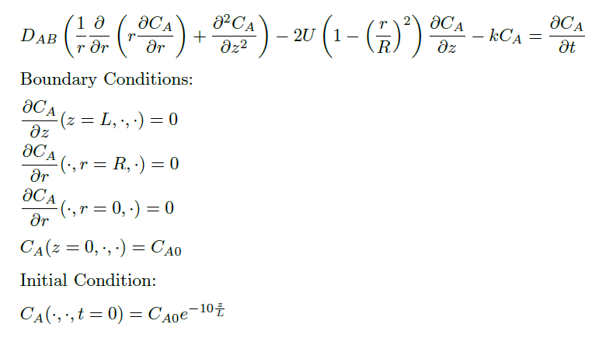
Two Dimensional Isothermal Model
Linear uncoupled model.
Unsteady initial condition models an initially inert reactor.
Boundary conditions model a constant initial concentration at the entrance of the reactor, no reaction at the exit and sides of the reactor and no concentration gradient along the centre axis line.
Notes:
The second problem we solve is the unsteady uncoupled linear non-constant coefficient two dimensional isothermal CDR equation. The initial condition once again models a reactor which is inert initially but for a rapidly vanishing smooth concentration profile in the mouth of the reactor. This is primarily intended to prevent any numerical issues arising from a discontinuous initial condition. The boundary conditions model a system where the inlet concentration of the reagent is known and no reaction occurs at the outlet and at the walls of the reactor. Since we have assumed the reactor is rotationally symmetrical it also makes sense to assume that there is no concentration gradient in the centre of the reactor. We again assume a reaction scheme where A turns into B and we use the same kinetic parameters as in the one dimensional problem.

Slide 22
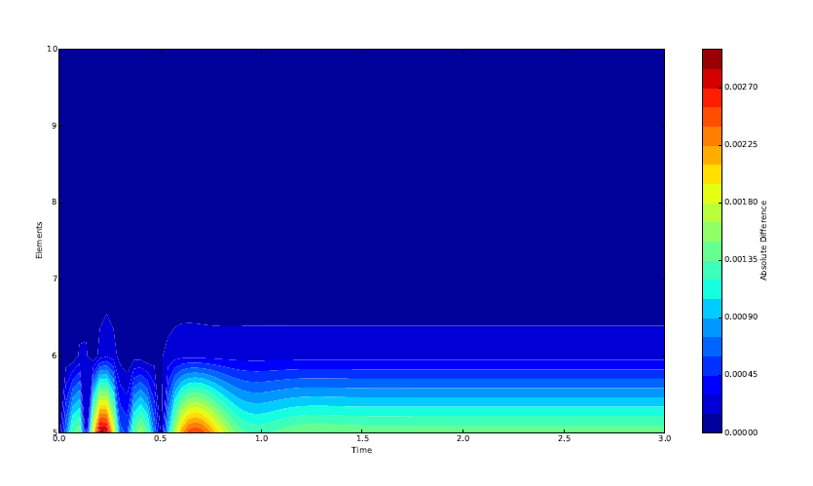
Two Dimensional Isothermal Model
Assume existence and uniqueness of the exact solution.
Assume that if the approximation converges it converges to the exact solution.
Numerical convergence at the end of the reactor:
Notes:
As we assumed existence and uniqueness for the one dimensional problem so we assume it here. This problem is slightly more difficult than before because it is higher dimensional and the coefficients are not constant. As before we assume that if the numeric solution converges it converges to the exact solution. Thus we only need to show convergence of the numerical scheme.
The way we approach this problem is the same as before. We effectively convince ourselves that since the numerical results seem to converge they actually do. To illustrate this we consider the same convergence diagram as before. We investigate the behaviour of successive differences of the approximate solution using more elements at the end point of the reactor over a large time span. We chose the end point because practically this is the most important region of the reactor. Since the model is two dimensional we report the average concentrations across the end radius of the reactor. The diagram shows that the absolute difference between successive approximations using one more column of elements each time rapidly approaches zero. Again colder colours indicate a smaller difference and warmer colours indicate a greater difference. As more elements are used we see that the difference between approximations become monotonically smaller. Based on this we believe that it is safe to conclude that the scheme does indeed converge.

Slide 23
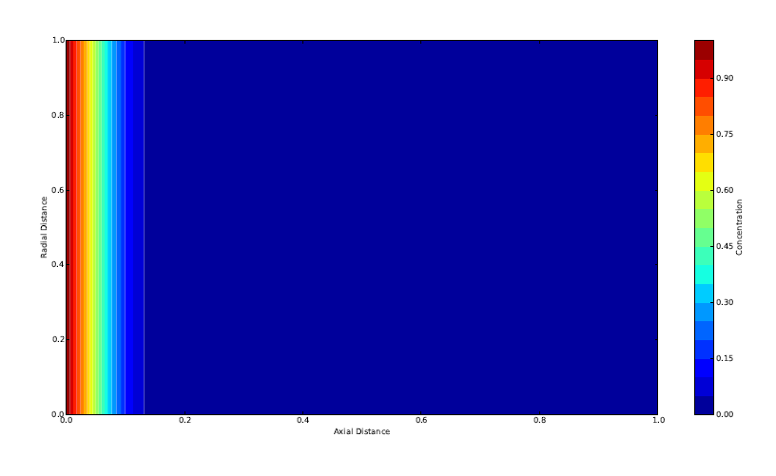
Two Dimensional Isothermal Model
Notes:
Since we trust that the scheme converges, all that is left is to inspect the transient response. This diagram illustrates the initial condition of the reactor. Colder colours indicate lower concentrations and warmer colours indicate high concentrations. We see that the reactor is initially devoid of any reagent except for the short profile shown in the beginning of the reactor.

Slide 24
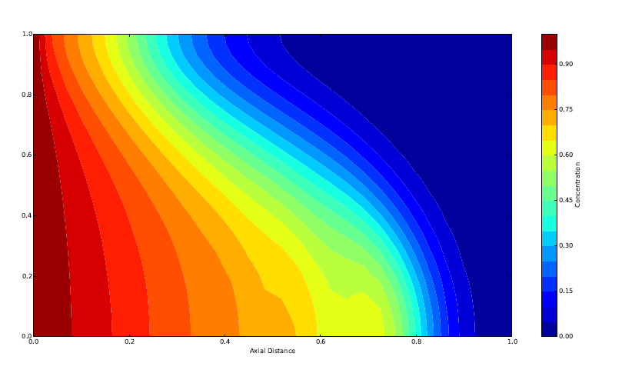
Two Dimensional Isothermal Model
Notes:
In this diagram we see the unsteady behaviour of the reactor at an intermediate time. It is clear that the convection term drives the reagents through the reactor in the characteristic laminar flow profile shape.

Slide 25
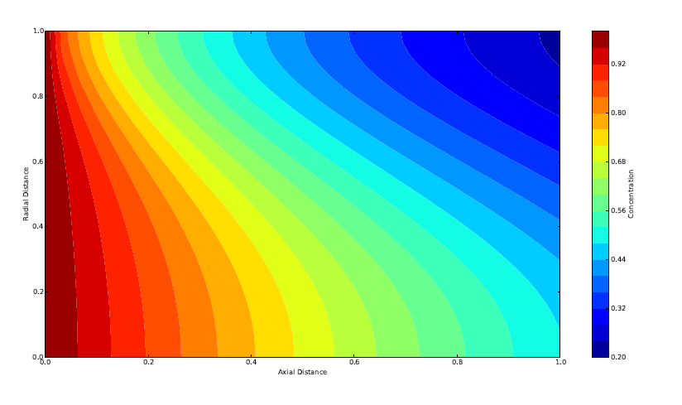
Two Dimensional Isothermal Model
Notes:
Finally, this diagram shows the steady state concentration profile of the reactor. The laminar flow profile is still apparent. It is interesting to note that the greatest concentration conversion occurs near the walls of the reactor. This is because the flow is the slowest there and thus the reagents have more time to react. Near the centre of the reactor the reagents are swept out quickly and thus do not have the same amount of time to react. Again such a profile is exactly what one would expect. Thus we conclude that the experiment was successful.

Slide 26
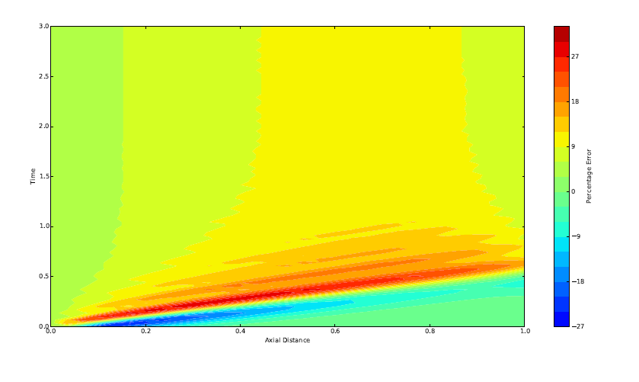
Simplification Comparison
Aris-Taylor is more accurate the closer the system is to laminar flow.
We have used laminar flow so we expect a small error.
Error magnitude is less than 6.1% at steady state at the end of the reactor.
Notes:
As discussed previously we must now compare the accuracy of the Aris-Taylor simplification in our model. The theory indicates that the closer the flow profile of the reactor is to laminar the better the approximation will be. Since our reactor fulfils this condition we do not expect a dramatically big error. By taking the average axial concentrations of the two dimensional model and subtracting the concentration of the one dimensional model we generate the figure shown here. Greener colours indicate smaller errors while warmer and colder colours indicate higher errors. It is clear that across the axis of the reactor there is significant error in the initial unsteady operation of the reactor but these errors level out as we approach steady state. At steady state the outlet concentration error is approximately 6%. The total error is never more than 30% including during the unsteady parts. This indicates that the simplification is not bad.

Slide 27
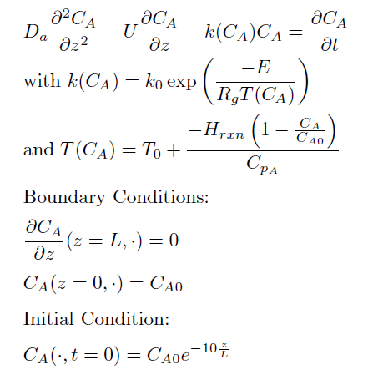
Non-Isothermal Model
Non-linear uncoupled model.
Lumped convection/diffusion coefficient.
Unsteady initial condition models an initially inert reactor.
Boundary conditions model a constant initial concentration at the entrance of the reactor and no reaction at the exit of the reactor
Notes:
It is now time to drop the isothermal assumption and move on to a significantly harder problem. The non-linear unsteady one dimensional non-isothermal problem is now investigated. The boundary conditions retain their meaning as before: we have a known inlet concentration and known initial concentration profile throughout the reactor. Additionally we assume no reaction takes place at the outlet boundary. We also assume the same reaction scheme as before.
The non-linear term is found in the reaction term. The composition of the exponential and hyperbolic functions make this quite a challenging problem. Up to now standard FEM techniques have been used to solve the models. By this I mean the local elements generated by the mesh have resulted in systems of linear algebraic equations which needed to be solved at each time step. However, the non-linear aspect of the problem changes everything.

Slide 28
Non-Isothermal Model
Suppose the trial solution is composed of some guess and a correction factor: u + δu.
Substitute the trial solution into the equation and linearize about the guess.
Solve the linear approximation for δu using standard FEM techniques.
Update the guess: u = u + δu.
Repeat this process until δu becomes suitably small.
Move on to the next time step.
The non-linearity of the model makes it more difficult to solve.
Use the Newton-Galerkin method to solve the system.
Discretise the time domain and at each time step apply the adjacent diagram.
Notes:
As opposed to the systems of linear differential equations which need to be solved for linear FEM problems using the Crank-Nicholson method, non-linear problems result in systems of non-linear differential equations which need to be solved. This is quite difficult so another approach is used. The book by Larson and Bengzon suggests the use of the Newton-Galerkin method to tackle these types of problems. Intuitively the method discretises the time domain of the problem and at each time step iteratively solves a system of linearised algebraic equations using something resembling the Newton-Raphson method. This process is then repeated for the next time step.
More specifically, at each time step we apply the diagram. We firstly suppose the solution of the equation at the current time step can be written in the form u + du where u is a guess and du is some correction. We substitute this assumption into the equation. We then linearise the resulting PDE about this guess and use standard FEM techniques to solve for the correction du. We then update our guess by adding du to u. We repeat this process until u converges in some sense. We then move on to the next time step using the Crank-Nicholson method as before. Based on physical arguments we know that the solution is going to be smooth and hence the guess at the current time step is simply the solution at the previous time step. Using this method the problem was solved.

Slide 29
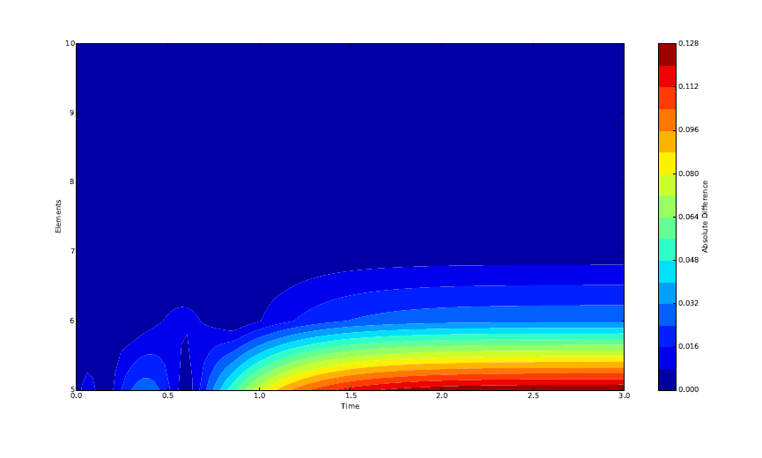
Non-Isothermal Model
Assume existence and uniqueness of the exact solution.
Assume that if the approximation converges it converges to the exact solution.
Numerical convergence at the end of the reactor:
Notes:
As before we assume the existence and uniqueness of the exact solution and that if the numerical approximation converges it converges to the exact solution. We again supply an illustration of our belief that the numerical solution does indeed converge by investigating the effect an increasing number of elements has on the estimate of the concentration at the reactor’s outlet. As before colder colours indicate a smaller difference and warmer colours indicate a larger difference. Qualitatively the results look very similar as before except that the order of magnitude of the successive differences is larger. In the linear one dimensional case the difference using 7 elements was less than 3 decimal places but now it is in the range of 2 decimal places. Clearly the non-linearity adversely affects the accuracy of the solution. That is, more elements are needed to get the same accuracy.

Slide 30
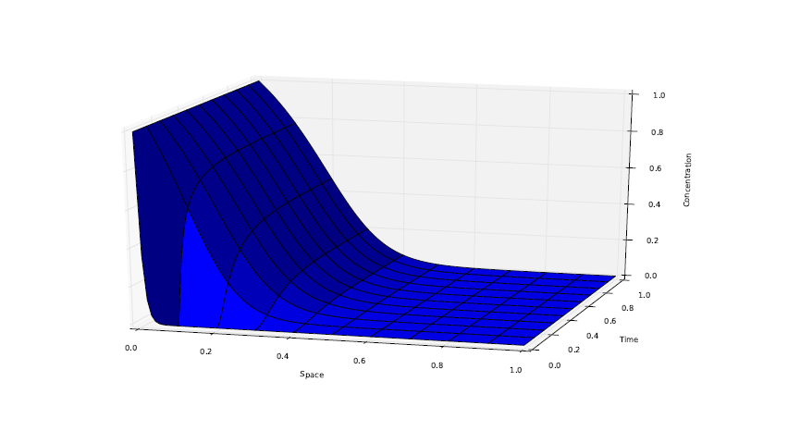
Non-Isothermal Model
Physically realistic.
The temperature increase across the reactor increases the rate which drives the reaction to completion faster.
Notes:
Since it seems like the numerical approximation converges we move on to the transient model of the system. Again everything seems to make physical sense. The reaction is exothermic which means that it gets hotter the more it reacts: an increase in temperature always increases the rate of any reaction. A rule of reaction engineering is: hotter is faster. We see that in the faster reaction all the reagents are consumed by the end of the reactor. Compare this to the isothermal case were the conversion was only 70%. Clearly it is very important to take temperature dependence into account when modelling a practical reactor.

Slide 31
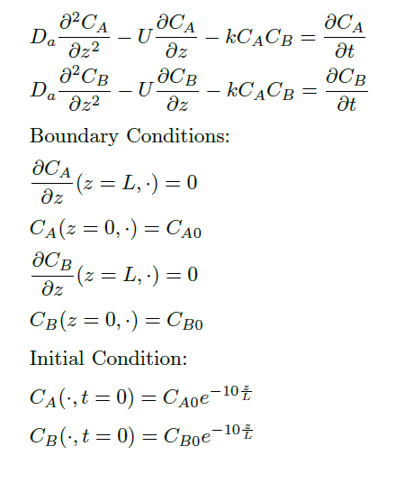
Coupled Non-Linear Model
Non-linear coupled model.
Lumped convection/diffusion coefficients.
Unsteady initial conditions model an initially inert reactor.
Boundary conditions model a constant initial concentration of both species at the entrance of the reactor and no reaction at the exit of the reactor
Notes:
The last model we investigate is a coupled non-linear model of an isothermal system. The purpose of this problem is to investigate the challenges introduced by the coupled nature of the problem. The reaction scheme we consider transforms reagents A and B into product C. The coupling of the two CDR equations is due to the reaction term. The boundary conditions and initial condition are exactly the same, albeit for two species, as before.

Slide 32
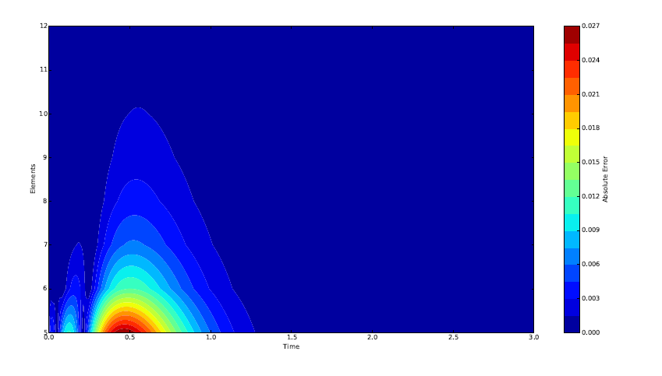
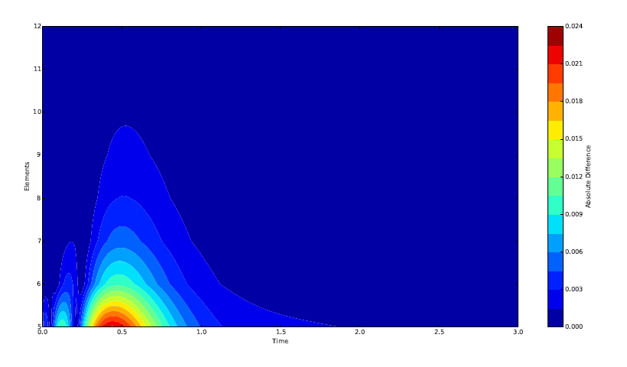
Coupled Non-Linear Model
Newton-Galerkin method is used to handle the non-linearity.
Again assume the existence and uniqueness of the exact solution and that if the approximation converges it indeed converges to the exact solution.
Notes:
We again use the Newton-Galerkin method to handle the non-linearity of the system and, as it turns out, the coupled aspect does not really make the problem harder to solve from an intuitive point of view. All that changes is the matrices we need to solve at each time step just get bigger because we stack the individual matrices generated by each equation into a larger one. We again assume the existence and uniqueness of the exact solution and furthermore assume that if the numerical solution converges it converges to the exact solution. By the same reasoning as before we justify our belief in the goodness of our numerical approximation by considering the convergence at the end point of the reactor. Again it seems that the numerical solution converges as the successive differences between solutions using more elements decreases.

Slide 33
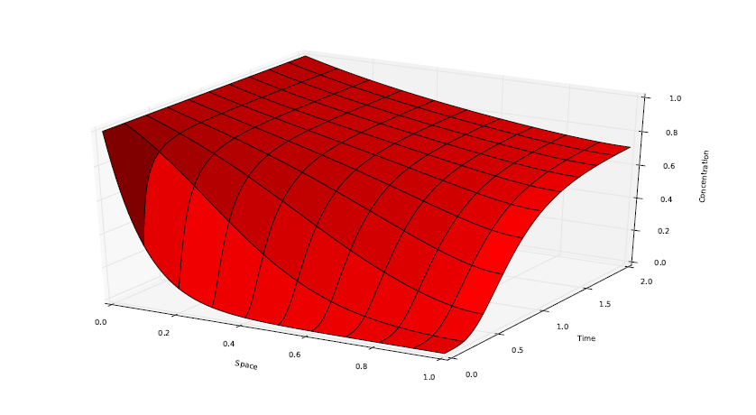
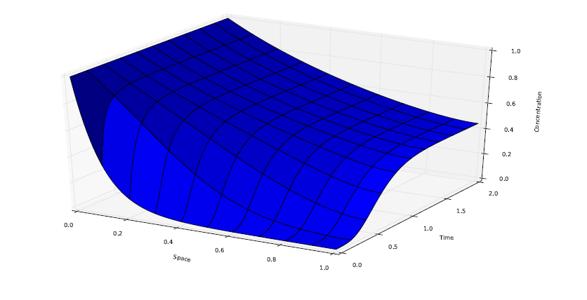
Coupled Non-Linear Model
Notes:
Finally we show the unsteady reactor profile of the system. To illustrate that the system behaves as desired the initial concentration of reagent B was set at half the value of reagent A. We expect then that the dimensionless concentration change of B will be twice that of A due to this starting condition. We see that the concentration change actually reflects this in the figures. We thus conclude that the modelling exercise was successful.

Slide 34
Conclusion
Successful application of the FEM to solve typical reactor design problems.
For the toy reaction studied in this project the Aris-Taylor approximation was quite accurate.
The FEM converged quickly in all simulations.
Notes:
In conclusion, we have solved 4 distinct yet related reactor design problems. The problems each built on each other in terms of complexity so that, in the future, more complex and realistic problems may be solved. The accuracy of the Aris-Taylor approximation was briefly investigated and we found that it is a good approximation, at least for this problem. We also found that very few elements were required for the FEM to converge to a solution – which we assumed was the exact solution.
The next step is to use the knowledge gained from this work to solve the coupled non-linear CDR and associated temperature system of equations.

Slide 35
Thanks for listening!

